Slide 1

The Scrum-Agile Approach to the SDLC
Jason Marcil

Slide 2
What is Agile?
In order to fully understand the Scrum-agile approach, we must first understand the agile methodology.
There are two primary methods used for the Software Development Lifecycle; the agile method and the waterfall method.
Agile Method | Waterfall Method
Real-time decision-making approach. Adaptive to changes that come up in the SDLC. Encourages collaboration between team members. Increased focus of client satisfaction. Reduced time to market. Can result in higher productivity and lower costs. | Imagine a waterfall. Once the water goes over the cliff, it cannot turn back. Strict plan driven approach. Linear and sequential. Has distinct goals for each phase of development. Once a phase of development is completed, the development proceeds to the next phase and there is not turning back. Very little room to accept changes from the original plan.
References
Charles G. Cobb. (2015). The Project Manager’s Guide to Mastering Agile : Principles and Practices for an Adaptive Approach. Wiley.

Slide 3

What is Scrum?
Scrum offers a framework and set of practices that keep everything visible.
Allows practitioners to know exactly what is going on and to make on-the-spot adjustments to keep the project moving towards desired goals.
Scrum is an empirical process as opposed to a “defined and predictive process.”
Collaboration between team members is a primary focus.
References
Charles G. Cobb. (2015). The Project Manager’s Guide to Mastering Agile : Principles and Practices for an Adaptive Approach. Wiley.

Slide 4
Scrum Team Roles
Product Owner
Scrum Master
Development Team

Slide 5
Product Owner
Responsible for managing the Product Backlog
Product Backlog management includes:
Clearly expressing the Product Backlog items.
Ordering the items in the Product Backlog to achieve goals and missions.
Optimizing the value of the work the Development Team performs.
Ensuring that the Product Backlog is visible, transparent, and clear to all, and shows what the Scrum Team will work on next.
Ensuring the Development Team understands items in the Product Backlog to the level needed.
Creating user stories based on the interest of the stakeholders.
References
Charles G. Cobb. (2015). The Project Manager’s Guide to Mastering Agile : Principles and Practices for an Adaptive Approach. Wiley

Slide 6
Scrum Master
The Scrum Master is responsible for ensuring Scrum is understood and enacted. Scrum Masters do this by ensuring that the Scrum Team adheres to Scrum theory, practices, and rules.
The Scrum Master serves the Product Owner in several ways, including:
Finding techniques for effective Product Backlog management.
Helping the Scrum Team understand the need for clear and concise Product Backlog items.
Understanding product planning in an empirical environment.
Ensuring the Product Owner knows how to arrange the Product Backlog to maximize value.
Understanding and practicing agility.
Facilitating Scrum events as requested and needed.
References
Charles G. Cobb. (2015). The Project Manager’s Guide to Mastering Agile : Principles and Practices for an Adaptive Approach. Wiley

Slide 7
Scrum Master
The Scrum Master serves the organization in several ways, including:
Leading and coaching the organization in its Scrum adoption.
Planning Scrum implementation within the organization.
Helping employees and stakeholders understand and enact Scrum and empirical product development.
Causing change that increases the productivity of the Scrum Team.
Working with other Scrum Masters to increase the effectiveness of the application of Scrum in the organization.
References
Charles G. Cobb. (2015). The Project Manager’s Guide to Mastering Agile : Principles and Practices for an Adaptive Approach. Wiley

Slide 8
Development Team
The Development Team consists of professionals who do the work of delivering a potentially releasable increment of “Done” product at the end of each Sprint.
Development Teams have the following characteristics:
They are self-organizing.
Development Teams are cross-functional, with all of the skills as a team necessary to create a product increment. For instance, there are developers that create the product and testers that create test cases and make sure the product works as intended.
Scrum recognizes no titles for Development Team members other than Developer, regardless of the work being performed by the person; there are no exceptions to this rule.
Scrum recognizes no sub-teams in the Development Team, regardless of particular domains that need to be addressed like testing or business analysis; there are no exceptions to this rule.
Individual Development Team members may have specialized skills and areas of focus, but accountability belongs to the Development Team as a whole.
References
Charles G. Cobb. (2015). The Project Manager’s Guide to Mastering Agile : Principles and Practices for an Adaptive Approach. Wiley

Slide 9
Phases of SDLC with Agile
The Scrum framework revolves around the product backlog and sprints. Sprints normally last anywhere from 1-4 weeks depending on the size of the overall project and the delivery date. Each sprint goes through the following process.
Sprint Planning
Daily Scrum (or Daily Standup)
Sprint Review
Sprint Retrospective
References
Charles G. Cobb. (2015). The Project Manager’s Guide to Mastering Agile : Principles and Practices for an Adaptive Approach. Wiley

Slide 10
Phases of SDLC with Agile
Sprint Planning Meeting
Involves all members of the Scrum team.
The product owner and development team determine which user stories will be part of the sprint.
User stories undergo final revisions and are prioritized.
The team decides how many stories can be completed in the sprint based on the size and level of effort each story will require.
Daily Scrum (or Daily Standup)
A daily check-in for everyone on the team to coordinate what’s going on, monitor progress, and to identify any obstacles that may be inhibiting progress.
During the Daily Scrum, each person on the team typically answers three questions:
What did you accomplish yesterday?
What are you going to accomplish today?
What obstacles are in your way?
The meeting is facilitated by the Scrum Master and it is often done in front of a Scrum board that indicates the progress of the tasks in the current sprint. This is also called a Daily Standup because team members usually stand during these meetings. They should only last about 15 minutes.
References
Charles G. Cobb. (2015). The Project Manager’s Guide to Mastering Agile : Principles and Practices for an Adaptive Approach. Wiley

Slide 11

Phases of SDLC with Agile
Sprint Review
The team presents the finished work to the product owner for their final review and approval.
A brief user acceptance test at the end of the sprint.
Product defects should be resolved before the sprint review unless the product owner has approved deferment of the issue to a later sprint.
Any significant changes to the user stories will be added to the product backlog for future sprints.
Sprint Retrospective
Review and discuss lessons learned from the sprint.
Look back and reflect on what went well and what did not go well.
“How can we make the next sprint better?”
References
Charles G. Cobb. (2015). The Project Manager’s Guide to Mastering Agile : Principles and Practices for an Adaptive Approach. Wiley

Slide 12
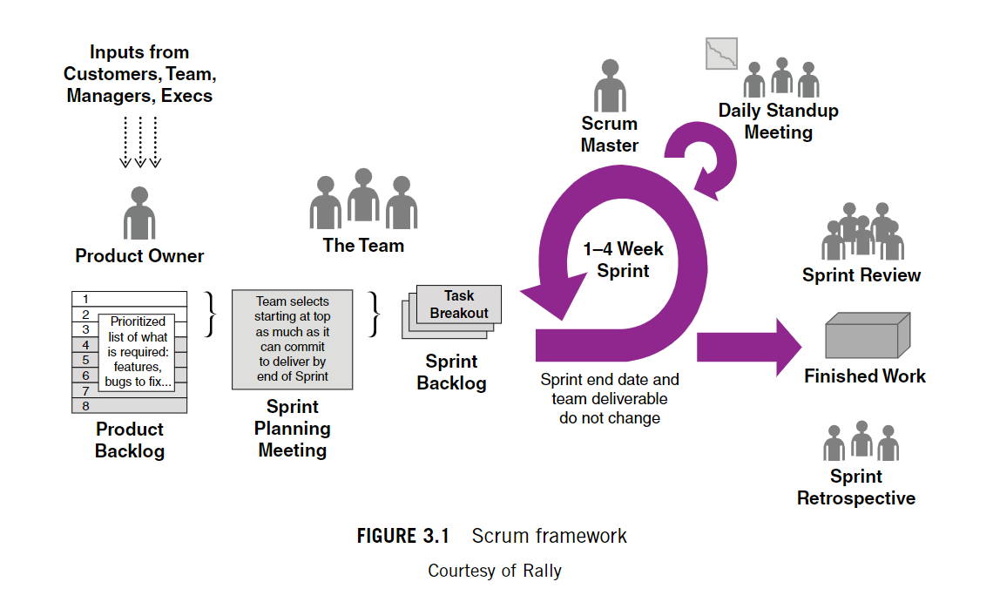
Scrum Framework
References
Charles G. Cobb. (2015). The Project Manager’s Guide to Mastering Agile : Principles and Practices for an Adaptive Approach. Wiley

Slide 13

If we used the waterfall method…
There would have been one plan created at the beginning of the development process.
The entire development process of the SNHU Travel booking tool would have been based on the plan.
It would have been difficult to adapt to the changes that the client brought to the Product Owner.
Everything that was finished along the process would not have been able to be revisited to make changes.

Slide 14
Factors to consider when choosing a waterfall or agile approach
Agile | Waterfall
Requirements are uncertain. Customer likes to be involved. Rapid changing market. Management wants working software, not artifacts. Few dependencies. Team members are multi-skilled. | Requirements are clear. Customer prefers to set requirements and see results. Quality over speed. Management demands metrics and documents. Many dependencies. Team members only know one role.
Eby, K. (2016, September 28). When to Choose Waterfall Project Management Over Agile. Smartsheet. https://www.smartsheet.com/when-choose-waterfall-project-management-over-agile#:~:text=An%20Agile%20methodology%20is%20a,preferable%20when%20dependencies%20are%20minimal

Slide 15
Sources Cited
Charles G. Cobb. (2015). The Project Manager’s Guide to Mastering Agile : Principles and Practices for an Adaptive Approach. Wiley.
Eby, K. (2016, September 28). When to Choose Waterfall Project Management Over Agile. Smartsheet. https://www.smartsheet.com/when-choose-waterfall-project-management-over-agile#:~:text=An%20Agile%20methodology%20is%20a,preferable%20when%20dependencies%20are%20minimal

